Slide 1
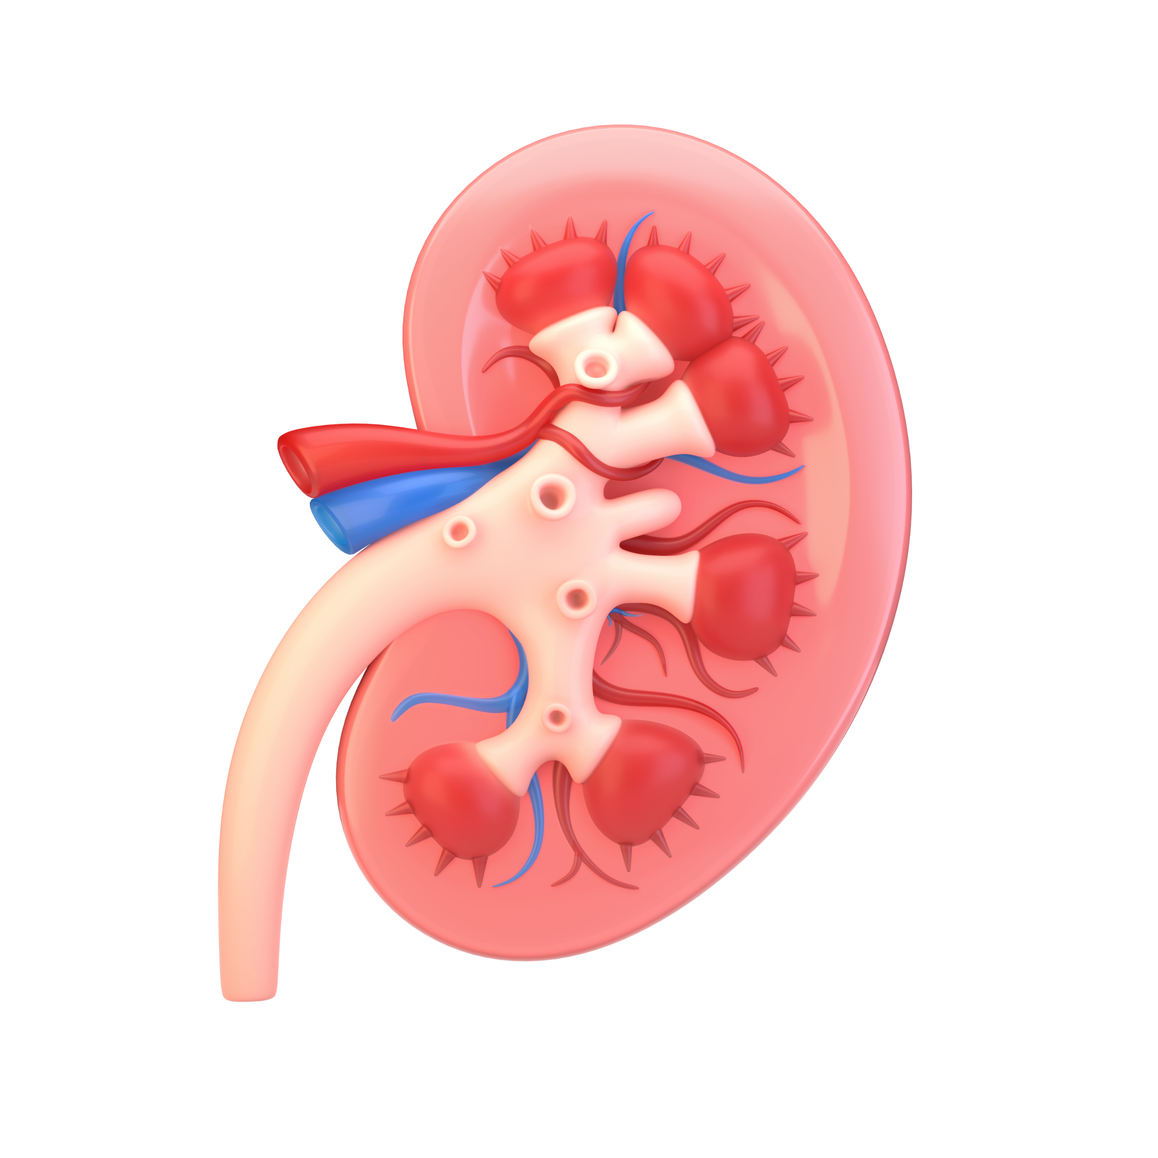
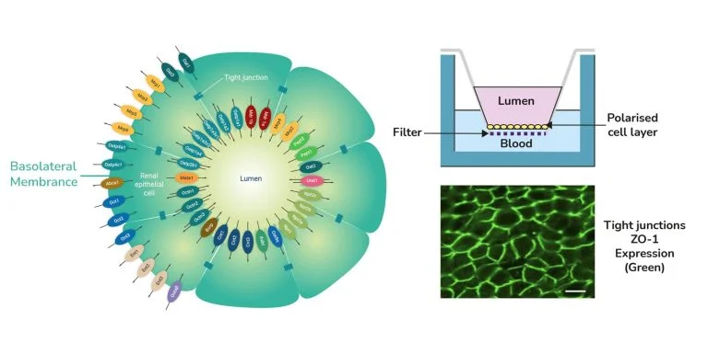
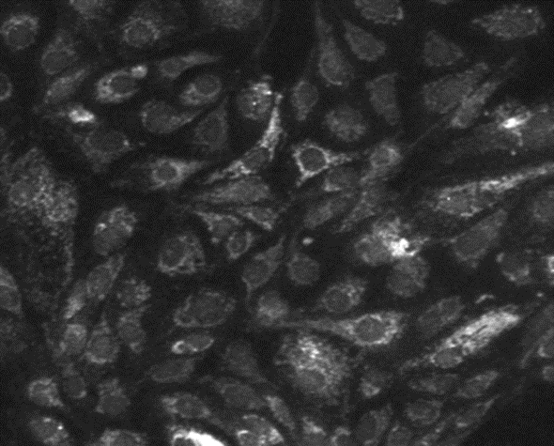
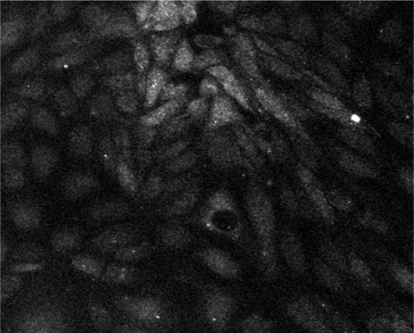
An in vitro model thar predicts Antibiotic Renal Toxicity
Jamie Jordan, Keith Pye, Kathryn Garner and Colin Brown
Newcells Biotech Limited, The Biosphere, Draymans Way, Newcastle Helix,
Newcastle upon Tyne. UK NE4 5BX
Introduction
aProximate Proximal Tubule cell monolayers express a full range of transport proteins and form tight monolayers when grown on Transwell filter supports
Antimicrobial resistance is a potentially catastrophic global issue that has the potential to cripple our ability to carry out even the simplest medical interventions. To combat this issue, we need to develop more comprehensive ways of screening antibiotics for potential renal toxicity. Our In vitro kidney model utilises freshly isolated Human proximal tubular cells (PTC) seeded out on 96-well Transwells™ that accurately express phenotypic receptor expression levels of in vivo kidneys. This allows for accurate drug response though native drug channels and receptor mediated uptake (Figure 1). By measuring kidney toxicity biomarkers (KIM-1, NGAL and CLUSTERIN) we can reliably predict early drug toxicity and potentially reduce time and cost of antimicrobial development.
Figure 1 ; aProximate proximal tubule cell (PTC) model. Schematic diagram of aProximate PTCs showing the expression of all key renal transporters (left) and the formation of tight junctions as shown by ZO-1 tight junction protein labelling (bottom right). Diagram of Transwell plates demonstrating the aProximate model: PTCs grown on filters remain fully differentiated as a polarised cell layer (top right).
Methods
Results
Cell Isolation
Cells were isolated as previously, (Brown, C. D. A., et al. Toxicol.
Appl. Pharmacol. 2008; 233(3):428-38) Once isolated, proximal tubule cells were seeded onto 96-well Transwell inserts (surface area of 0.143 cm²) at a seeding density of 200,000 cells per ml. Cells were cultured on the inserts for 5-9 days and maintained in a humidified CO₂ incubator until reaching a trans-epithelial electrical resistance (TEER) value of 700 Ω. The electrical resistance was measured using a voltohmmeter.
Treatment
Media containing each concentration of Antimicrobial compound, was added to the Apical and Basolateral chamber in triplicate and incubated at 37°C for 72 hours. ATP cell viability, MesoScaleDiscovery biomarker ELISAs were run to assess cellular damage and stress markers. TEER was taken over time to assess the confluency of the PTC monolayer (Figure 2). Once TEER reached 700 Ω.
Imaging
High content imaging (HCI) method: Primary human and PTCs (aProximate™)¹ were cultured on 96-well black-walled plates for up to 5 days, before being exposed to 50µg/mL FITC-albumin for 4 hours. Live cell imaging using the ImageXpress Pico high content imaging system (Molecular Devices), and subsequent analysis using Cell Reporter Xpress (CRX) software enabled uptake of FITC-albumin to be quantified. Expression of Megalin and Cubilin in these monolayers was confirmed by immunostaining (Figure 3).
Figure 9; FITC-albumin uptake in Human monolayers. K_{m} denoted by dotted line.
Vancomycin and Polymyxin B (PmB) TEER were taken after 72hrs of treatment to assess monolayer integrity. As the compound concentration increases the TEER reading decreases, indicating a loss of monolayer integrity and potential cell death.
Minimal changes in ATP at the lower concentrations of Vancomycin (Figure 6), begin to show small increases in Biomarker production. Once ATP drops by 10%, biomarker levels increase, indicating PTC toxicity. At 10mM, ATP levels drop to 60% resulting in a significant elevation in Biomarker production (NGAL increase to over 400%). This demonstrates elevated kidney toxicity.
Polymyxin B shows no change in ATP levels up to 50uM concentration with minimal changes in Biomarker detection. As the concentration increases to 100uM, ATP decreases and KIM-1, NGAL begin to increase. At 300uM ATP drops to 40% increasing KIM-1 production to 400% and NGAL to 350%.
coating 1
coating 2
Figure 4; Vancomycin Pre-treatment TEER readings
Figure 5; Polymyxin B Pre-treatment TEER readings
Figure 6; PTCs treated with Vancomycin over 72hrs. ATP levels measured (red) KIM-1 release measured (blue) NGAL production measured (green) and CLUSTERIN levels measured (purple).
Figure 7; PTCs treated with Polymyxin B over 72hrs. ATP levels measured (red) KIM-1 release measured (blue) NGAL production measured (green) and CLUSTERIN levels measured (purple).
Figure 2; Pre-treatment TEER over 4 days. TEER was monitored daily after day 2.
Figure 3: The monolayers of human PTCs express the endocytic receptors Megalin (Left) and Cubilin (Right).
200 µg/ml of Gentamicin was used as a positive control against a no-treatment group. Gentamicin ATP dropped by ~30% compared to control. All three biomarkers were elevated compared to control.
Summary
Proximal tubular cells grown on Corning Transwell inserts display Megalin and Cubilin expression comparable to in vivo levels.
KIM-1,NGAL and CLUSTERIN are effective early biomarkers for PTC toxicity.
Our assay is a high-throughput in vitro model of the proximal tubule which can be utilised for antimicrobial nephrotoxicity screening via sensitive, FDA-approved biomarkers of kidney injury.
References
Figure 8; Media control ATP has no treatment and contains Media and cells (Blue). Compared to treatment of 200ug/ml Gentamicin (Red).
Figure 9; FITC-albumin uptake in Human monolayers. K_{m} denoted by dotted line.
References
Bajaj, P. et al. (2020)
Brown, C. D. A., et al. Toxicol.
Appl. Pharmacol. 2008; 233(3):428-38
Further details available online or contact us at enquiries@newcellsbiotech.co.uk
A FITC-albumin uptake curve was generated (Fig. 9), which allowed for the K_{m}, the FITC-albumin concentration at half receptor saturation, to be determined (13.57 µg/mL for human monolayers).

